Slide 1

Literature Review
Paper 1: Practical Distributed Programming in C++
Paper 2: On the Validated Usage of the C++ Standard Template Library
Paper 3: Relaxing the One Definition Rule in Interpreted C++

Slide 2
Paper 1:Practical Distributed Programming in C++
The C++ language specification lacks support for distributed-memory platforms at higher levels of abstraction.
This work tackles this challenge by providing a direct path from single-thread to parallel for distributed systems, while keeping the syntax and semantic of the C++ language and STL.
This works contributions:
Design and implementation of a stack for distributed programming in native C++, with STL-compliant distributed containers, iterators, and algorithms.
a pattern-based formulation for several distributed STL algorithms, with sequential and parallel semantics expressed in terms of execution policies, endowed with optimizations for various categories of algorithms.
a performance study on a preliminary implementation of the approach, backed by experimental evaluation.

Slide 3
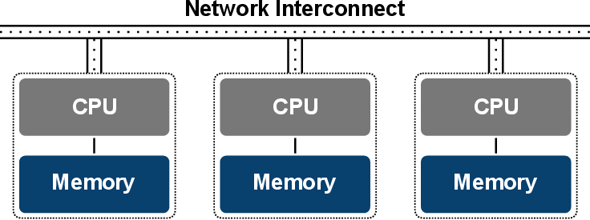
Distributed Computing and memory systems
Distributed memory parallel systems consist of a set of processing nodes interconnected by a high-speed network. Each node consists of a processor and local memory. In the case of a non-shared, distributed memory system, each processor only has access to its local memory and a message system is used to move data across the network between processors.
Distributed shared memory (DSM) is a form of memory architecture where physically separated memories can be addressed as one logically shared address space.

Slide 4
Distributed Containers
Distributed Iterators:
Distributed iterators have std::iterator type and preserve the semantics of STL iterators.
STL algorithms operate on ranges (i.e., sub-collections). A range is specified as a pair (b, e) of iterators, denoting the range r = [b, e) where r is referred to as a distributed range if b and e are distributed iterators.
Replacing std::<container> with dstd::<container> results in a distributed implementation with distributed iterators and algorithms.
Dereferencing a distributed iterator produces a distributed reference.
A distributed reference has the same semantics as a regular reference. However, semantics of dot-based syntax could not be mirrored due to C++ limitation of no overloading of dot operator.

Slide 5
Local iterators:
Valid only on the corresponding locality and provide direct access to the underlying data, with no need for any translation.
To avoid the overhead associated with direct dereferencing of distributed iterators (due to translation logic involved to identify the locality to which the value is physically mapped).
Lazy References: distributed reference allows accessing the value in a lazy manner
When a distributed reference appears as left side operand of an assignment, a write-access is triggered to the referenced location; conversely, if is being casted to its referenced value (e.g., it appears as right-side operand), a read-access is triggered instead.
Though now overhead is there as remote operations are triggered synchronously.
This is tackled by the use of value caching in iterators over associative containers (e.g.: maps, sets).
Iterators Arithmetic:
Contiguous containers:
Iterator arithmetic can be resolved locally, without triggering remote tasks.
Since the data distribution across the localities is fixed for the underlying data structure, it is possible to identify the locality where the data resides as a function of the position referenced by the iterator.
Associative Containers:
As the underlying data structures adopts a storage based on linked lists, their structure might change over time. Hence remote tasks might be triggered to the locality in which the next item resides.

Slide 6
Distributed Algorithms
Naively passing distributed ranges to STL algorithms would result in performance penalties due to fine-grained (remote) read-write dereferencing. In C++17, this problem has been addressed for shared-memory platforms through the introduction of execution policies.
This approach is mirrored to introduce two execution policies: distributed-parallel and distributed-sequential which provide parallel and sequential semantics for distributed algorithms respectively.
Single Range Access:
Under both execution policies, perfect partitioning can be exploited to guarantee that each locality l works on a portion rl of the input range that is located at l , avoiding any remote access.

Slide 7
Multi Range Access:
multi-range algorithms do not guarantee that all the sub-ranges accessed by a locality l during the computation are co-located in l.
Optimizations to tackle the issue:
LOCAL-ASSIGN : to avoid the overhead associated to accessing distributed iterators over node-local sub-portions
ASYNC-REMOTE-ASSIGN : to hide the latency associated with remote output operations over physically contiguous memory blocks (e.g., arrays), through asynchronous, block-wise remote memory copying;
ASYNC-INSERT : based on asynchronous insertions through buffered insert-iterators, to mitigate latency even when no assumptions can be made about the data layout (e.g., associative maps).

Slide 8
Experimental Results
Single Range Algorithms:
Distributed-sequential execution times are comparable with STL executions and distributed-parallel executions scale linearly with the number of localities.
STL algorithms are slower than their distributed one-locality counterpart (e.g., reduce on sets), yielding super-linear speedup in the distributed-parallel policy.
Performance of single-range distributed algorithms
over containers with 10^9 items, with respect to std executions.
Note that the assignment-based generate algorithm
on sets is missing, as prescribed by the STL specification.

Slide 9
Multi Range Algorithms:
Since the performance depends on the physical distribution of the output range over the involved localities, we consider two boundary conditions. In the aligned case, all the output operations are directed to the same locality that originates the operation, thus no task is executed remotely. Conversely, in the unaligned case, all the output operations are directed to a different locality, turning into remote tasks.
Larger gains can be observed when optimizing against remote task executions in the unaligned cases, whereas the improvement fades out on small containers when increasing parallelism.
On set ranges, Async-Insert prevents the latency induced by remote accesses to grow with the number of localities and the result holds also in the unaligned case.
Async-Remote-Assign effectively reduces the slowdown. The scaling provided by parallel executions is almost ideal in all cases covered by Local-Assign and Async-Insert, and still proportional to the number of localities with Async-Remote-Assign.
Optimized distributed-parallel transform: Local-
Assign (aligned array ranges), Async-Remote-Assign (unaligned array ranges), and Async-Insert (set ranges)

Slide 10
Paper 2: On the Validated Usage of the C++ Standard Template Library
The usage of C++ STL does not guarantee error-free code. Contrarily, incorrect application of the library may introduce new types of problems. Unfortunately, there is still a large number of properties that are tested neither at compilation-time nor at runtime.
In this paper, we present approaches that analyze the usage of STL because it is clearly seen that only the compilation validation is not enough to realize the possible misusages. We take advantage of different techniques: template metaprogramming, static analysis, debugger-based non-intrusive solution and an aspect-oriented method.

Slide 11
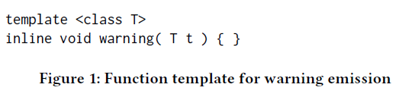
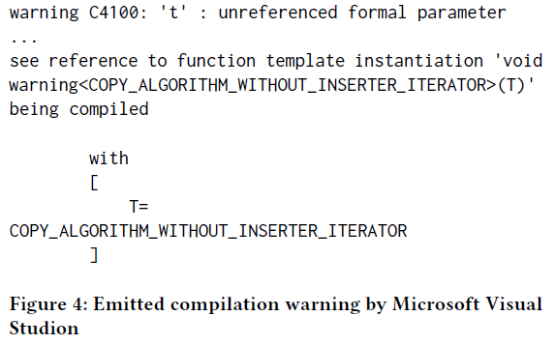
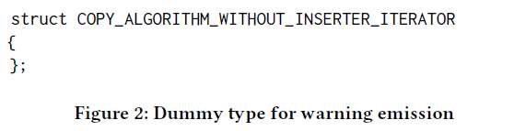
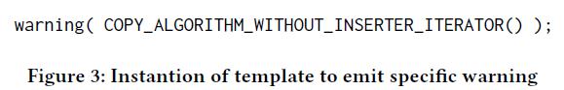
Metaprogramming
This approach is based on the template construct of C++ which is able to evaluate Turing-complete checks at compilation time. One can modify the STL implementation to evaluate specific instantiations.
The template generates warning when it is instantiated and its template argument is highlighted in the warning diagnostics, so new kind of warning requires a dummy type. For e.g.:

Slide 12
Static Analysis
Our approach is based on pattern matching on the abstract syntax tree (AST) of the analyzed program source code. The AST provides sufficient amount of information to answer several questions regarding the source code. Clang compiler infrastructure is used to do the above.
To collect the compilation arguments, fake compilers are used that logs the parameters and forwards them to a real compiler afterwards.
After the AST is retrieved, the pattern matching process begins. Multiple patterns are matched lazily on the AST with only one traversal. The source positions for the matched nodes in the AST are collected. The source positions in the collected results are filtered based on exclude lists that contain the false positive matches. These exclude lists have to be maintained by the user of the tool. Afterwards, the positions are translated into user-friendly warning messages to emit.

Slide 13
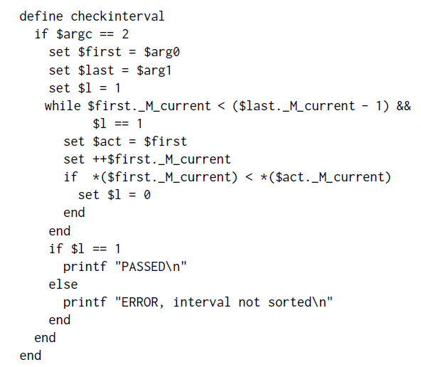
Debugger Based run-time Validation
This approach is based on the gdb debugger tool. Breakpoints are setup on specific locations in the library and when the execution is suspended the intervals, iterators, the state of the containers, etc. are evaluated. After evaluation, one can continue the execution or indicate an error. Correct and convenient usage of gdb requires compilation with debug mode enabled.
In this case, debug information makes the application significantly slower.
However, the gdb scripts are not sophisticated properly, so an automation tool was developed to do the required steps properly.
Source code of the debugger script that checks
whether an interval is sorted (say for a function like lower_bound)

Slide 14
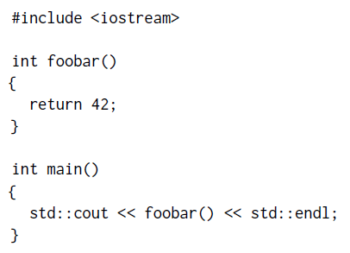
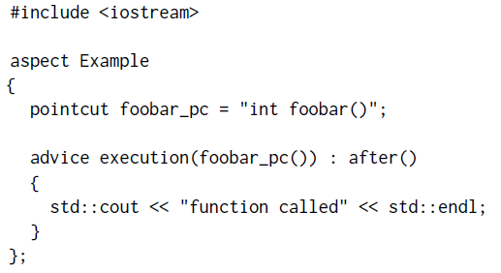
Aspect Oriented Approach
The main idea behind this technique is to extend or modify the original program runtime behavior without changing the source code. It usually is done by adding extra source code just before the compilation. This extra source code is woven into original source code, but it is not changed physically.
Here AspectC++ is used which transforms the original source and the defined aspects into a new source code which is standard C++ code and it can be compiled with C++ any compiler.
After applying the code using AspectC++, it prints an extra line “function called” after “42” on standard output.
(in real application error could be printed after condition checking)
Example function foobar() and main().
AspectC example for the foobar() function

Slide 15
Evaluation
For the evaluation of methods, we consider the following properties: sophistication, intrusiveness, STL implementation specificity, applicability and general performance.
Sophistication is an essential question regarding how many problems can be detected by the approach.
Intrusiveness defines whether a solution requires changes in the implementation of the STL. Non intrusive approaches are preferred to intrusive methods.
Preferred methods do not need to know the actual implementation of the library as there are many. STL implementation-specific solutions are more complicated to port to a different platform.
Applicability defines what kinds of artifacts are supported with the proposed methods.
Actual performance issues cannot be compared correctly because some approaches work at runtime(AOP, debugger based) and other approaches that validate at compilation time(static analysis, metaprogramming). However, we can compare the general performance.

Slide 16
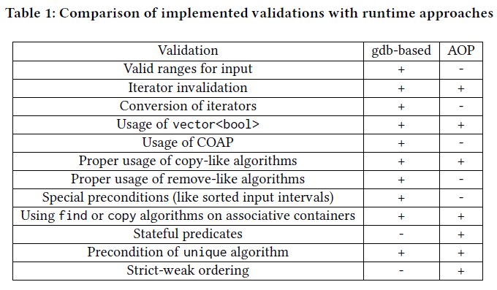
Sophistication
Runtime approaches can detect more problems (as more info is known about the program).
Static analysis is more sophisticated than metaprogramming.
Validation based on the gdb is considered slightly more sophisticated than the aspect oriented approach as validations can be implemented in the former.

Slide 17
Intrusiveness
Metaprogramming is intrusive (due to modification of STL implementation) whereas the rest are non-intrusive.

Slide 18
STL-implementation specific
Metaprogramming is implementation specific as it is intrusive.
As the checkers in static analysis are implemented regarding C++ standards it is not library-specific.
As the gdb requires line number of the source code library to insert breakpoints it is implementation specific.
Aspect oriented approach is not library specific and thus can be used with many STL implementations.

Slide 19
Applicability
As metaprogram checkers are evaluated by template instantiation, only code actually compiled can be supported, and thus no template(header-only) libraries.
Static Analysis can be used source code no matter whether it is a code of a library or an application.
As debugger approach requires an entry point for execution, libraries are not supported.
The aspect oriented approach patches the library with runtime validations, it does not matter from where the STL functionalities are invoked.

Slide 20
General Performance
Metaprogramming is the best regarding the performance as it is evaluated during the usual compilation process with some extraordinary template instantiations with no runtime overhead.
Static analysis runs separately from the compilation, so it requires a new build process which makes the approach slow, but fortunately, it has no runtime overhead.
Debug mode for compilation and execution means significant runtime overhead.
The aspect-oriented solution uses static analysis technique to find the “breakpoints” that performs much better than gdb.

Slide 21
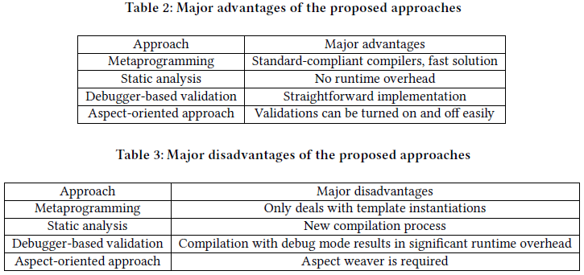
Overall
Runtime approaches do not generate false positive and true negative results, these tools report only when the problem actually occurs.
Runtime approaches are able to detect more problems, but static analyses are not so far.
Runtime approaches are preferred during testing process because they cause runtime overhead, unnecessary log messages and may cause changes in the execution.

Slide 22
Paper 3: Relaxing the One Definition Rule in Interpreted C++
Interpreting C++ presumes a single ever growing translation unit that define away some of the ODR use-cases. Therefore, it may well be desirable to relax the ODR and, consequently, to support the ability of developers to override any existing definition for a given declaration.
In this paper, Cling, a Clang/LLVM-based C++ interpreter, is extended to enable redefinitions of C++ entities at the prompt.
To achieve this, top-level declarations are nested into inline namespaces and the translation unit lookup table is adjusted to invalidate previous definitions that would otherwise result in ambiguities.
Formally, this technique refactors the code to an equivalent that does not violate the ODR, as each definition is nested in a different namespace.
Furthermore, any previous definition that has been shadowed is still accessible by means of its fully-qualified name.

Slide 23
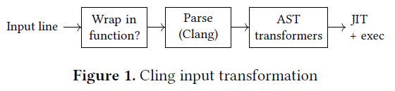
Background
ROOT Project:
ROOT is a cross-platform C++ framework for data processing in the high-energy physics area, developed mostly at CERN. The Cling interpreter is used is part of the ROOT project.
It has a data model to store data, statistics and data analysis libraries, visualization tools and an interactive C++ interpreter, Cling.
It also provides bindings for other languages such as Python, R and Mathematica
Cling:
Cling leverages the Clang/LLVM infrastructure for parsing and code generation, meaning that it only has to deal with issues derived of C++ interpretation.
If input line cannot be proved to be valid, it will be wrapped in a uniquely- named function
After turning the code into valid C++ code it is normally parsed by Clang.
The resulting AST may be transformed with additional transformation blocks (which are executed after the AST is created) to support the Cling features.
Lastly the LLVM does the just-in-time compilation and execution.

Slide 24
Proposal for Entity Redefinition
The described procedure relies on nesting each redeclaration into its own scope by using C++ inline named namespaces.
Members of an inline namespace can be accessed as if they are members of the enclosing namespace, i.e. names introduced by such namespace “leak” to the enclosing scope. If a name is made available in the enclosing scope through more than one inline namespace, unqualified lookup for the given name is ambiguous. Manually adjusting the lookup table rectifies this is situation.
Cases and Exceptions:
Only named declarations that are definitions, or that may be defined later, i.e. forward declarations, should be moved into a namespace.
Declarations with the using-directive (e.g., using namespace std;) and using-declaration (e.g., using std::vector;) are excluded from any of the aforementioned transformation since issuing twice a using-directive in a given scope does not pose any problem.

Slide 25

Invalidation of Ambiguous Unqualified Names:
Target top-level declarations are enclosed in inline namespaces, but as enclosing namespaces have the inline namespace's members visible to them, declared names still can be accessed as if they were not part of any namespace.
If the same name is “leaked” to the enclosing scope via multiple inline namespaces then ambiguity will arise.
Resolving Ambiguity:
Each declared name in inline namespaces are made visible in not only the namespace lookup table but also the enclosing (or translation unit) lookup table.
Thus existing entries in the TU lookup table with same name have to be removed, except for the entries which can be considered as overloaded.
Also, as the enumerators introduced by unscoped enumeration are reachable from TU scope they too have to be invalidated.
Next, further non-definition declarations of the same name are discarded to avoid ambiguity.
Exceptions: Overloads, Unscoped Enumerations, etc. Some particular cases require either to preserve existing lookup table entries, or to invalidate additional ones, namely:
Function Overloads: Overloaded functions are not ambiguous as compiler is able to distinguish between them, thus they need not be removed.
Unscoped Enumerations: An unscoped enumeration is a transparent context, i.e. enumerators are made visible in the parent context. Because declared enumerators are made visible in the enclosing inline namespace, and therefore in the translation unit, the removal of all those names from the TU lookup table shall also be considered.
Declaration after definition: Any non-definition declaration that comes after a definition is ignored, e.g.

Slide 26
Implementation
As mentioned before, Cling’s architecture allows for AST transformation before the JIT compilation takes place, all the additional handling required for supporting redefinition has been fitted in the new DefinitionShadower AST transformer. (run after AST but before existing DeclExtractor Transformer)
The DefinitionShadower AST Transformer:
Namespacing top-level declarations:
Creates “if needed” namespace declaration (say DefinitionShadowerNS) and adds it to the TU declaration list.
Removes declared names from the existing TU declaration list.
Sets context of the declaration to the DefinitionShadowerNS.
Adds it to the DefinitionShadowerNS declaration list.

Slide 27
Adjusting the TU lookup table (second step in previous point)
Lookup the given name in TU and iterate through results, skipping over non-definitions.
Candidates are checked for overloading, if so they are kept otherwise removed from the TU lookup table.
Invalidate any previous definitions of enumerators (as they are visible in TU).
Note: The shadowed names are removed from TU lookup list only, they are still present in their namespace list so they are still accessible via qualified lookup e.g. __cling_N50::decl.
Enabling/Disabling the New Transformation
The AST transformer may be turned on/off by using EnableShadowing compilation option.
If EnableShadowing is set to 0 raw input mode is enabled, otherwise valid named top-level declarations are transformed except for following cases:
Shadowing is enabled for declarations parsed from an input line, thus #include files are not included.
UsingDirectiveDecl and UsingDecl are not transformed.
Shadowing namespace members is currently not supported.
Cling copies input lines in a distinct virtual file and starts parsing it. Consequently, at end of file, it emits pending template instantiations. These instantiations are fed through AST transforms as top-level declarations, and should be ignored by DefinitionShadower.
Limitations
Shadowing a global object does not free the storage occupied by it as even though it cannot be found via lookup table, the memory it referred to is still allocated. Also these objects can be referenced using there qualified name.
Type introspection in C++ during runtime might be a problem as nesting type declarations into a namespace changes the qualified name of types

Slide 28
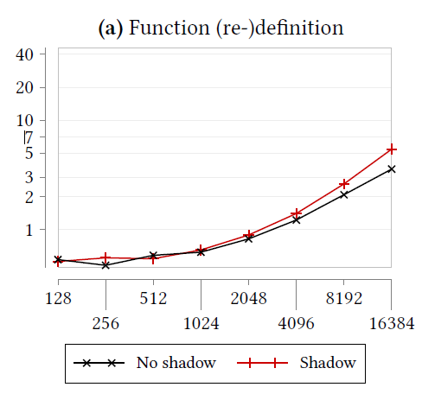
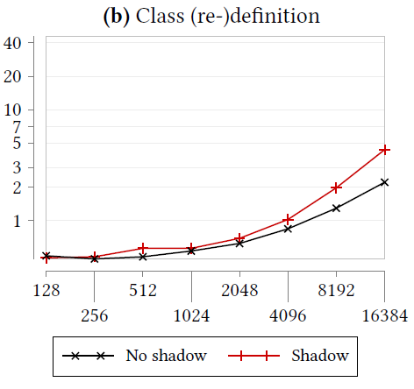
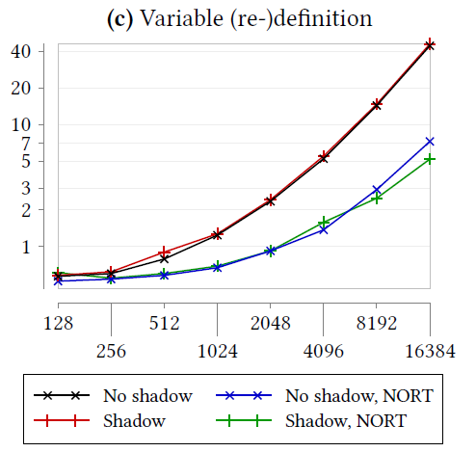
Validation
The paper does provide an extensive set of examples with associated AST and TU lookup table for verification but due to lack of space it has been skipped.
Overhead is also calculated for the transformations performed
For function and class definition tests both incur 4-52% overhead with Shadowing enabled vs disabled and the time have a positive trend with the number of declarations.
Tests for variables still increases time with increasing declaration but exhibits much higher runtimes with smaller overhead ranging 2-13% with Shadowing enabled. Can be attributed to the fact that wrapper functions need to be generated around variable declarations.
With the –noruntime command the overhead reduces to -28-15% with Shadow version being faster in some cases.
The proposed technique is working is currently being used by domain experts at CERN.
Y axis: time
X axis: number of declarations

